Slide 1

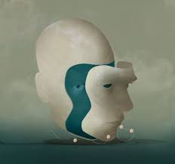
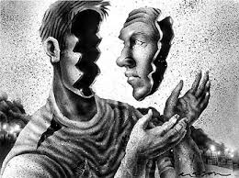
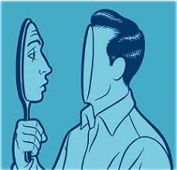

Slide 2
The Self
We know what it is….
People use the term all the time….
But how is it defined?….
self
The totality of the individual, consisting of all characteristic attributes, conscious and unconscious, mental and physical.

Slide 3
The ABCs of the Self
Affect: How do we evaluate ourselves, enhance our self-images, and defend against threats to our self-esteem?
Behaviour: How do we regulate our actions and present ourselves according to interpersonal demands?
Cognition: How do we come to know ourselves, develop a self-concept, and maintain a stable sense of identity?

Slide 4
Three Components of the Self
1) Physical self: one’s body
2) Social identity: one’s self-schema
social roles
traits
future hopes/goals
past memories
3) Active agent: one’s thoughts and actions
decisions
behavior

Slide 5
Functions of the Self
Interpersonal tool
Decision Maker
Self-Regulation

Slide 6
The Role of the “Self”
The self concept is at the center of our understanding of the social world.
Private, inner self – how we truly see ourselves
Public, “outer” self – how we want others to see us

Slide 7
COGNITIVE: The Self-Concept
Self-concept = individual’s perception of his or her abilities, personality, and other attributes
Self-concept consists of our thoughts and feelings about our own characteristics
Self is an important object of our attention.
party effect.(Mixed feeling)
Self-Concept: The sum total of beliefs that people have about themselves.
Self-concept is made up of self-schemas.
Self-Schema: Beliefs about oneself that guide processing of self-relevant information.

Slide 9
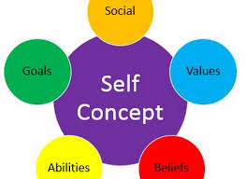

Slide 11
Possible selves
Possible selves are one’s conceptions about the kind of person one might become in the future.
Possible selves are developed from past experiences, current behavior and future expectations.

Slide 13
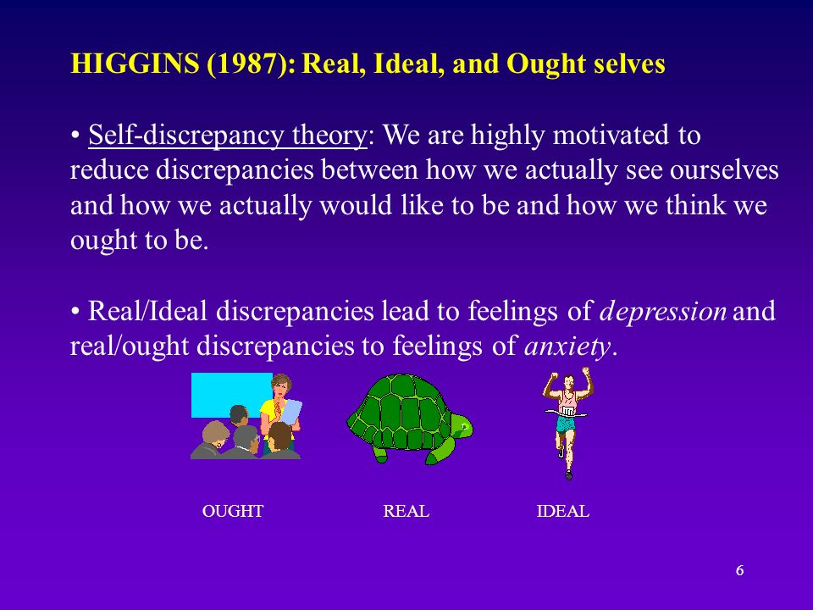

Slide 14
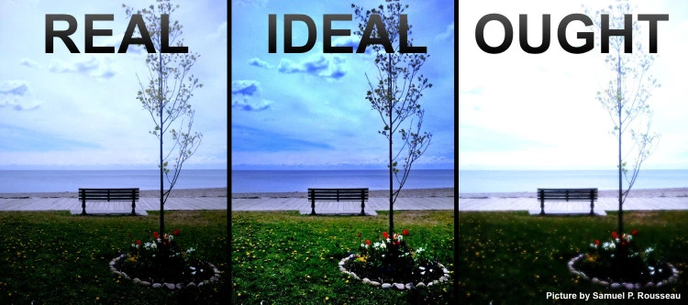

Slide 15
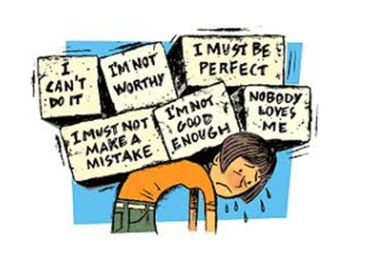

Slide 16
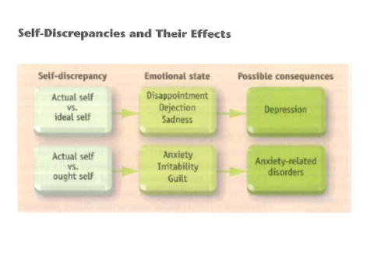

Slide 18
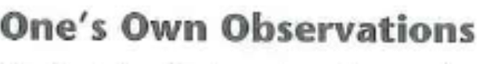
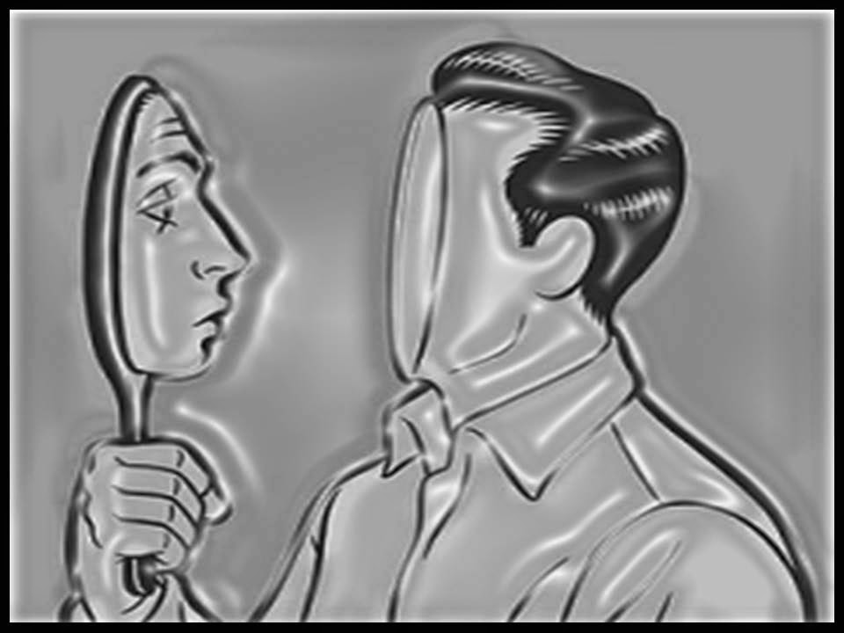

Slide 19


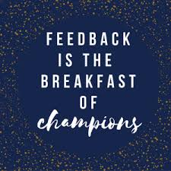
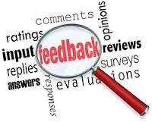

Slide 20
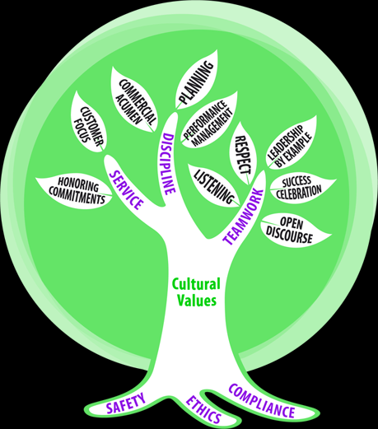
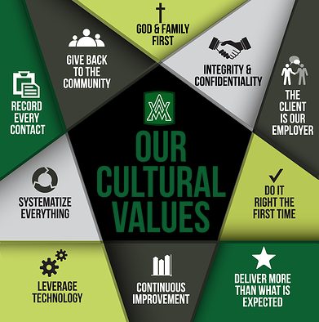

Slide 21
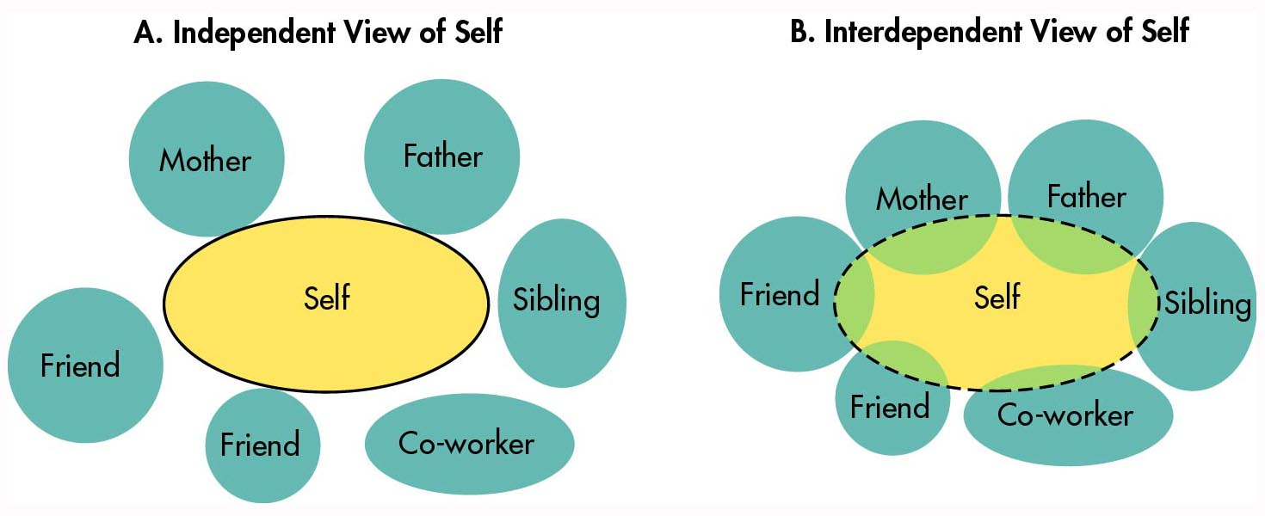
Cultural Conceptions of Self

Slide 24
